Slide 1
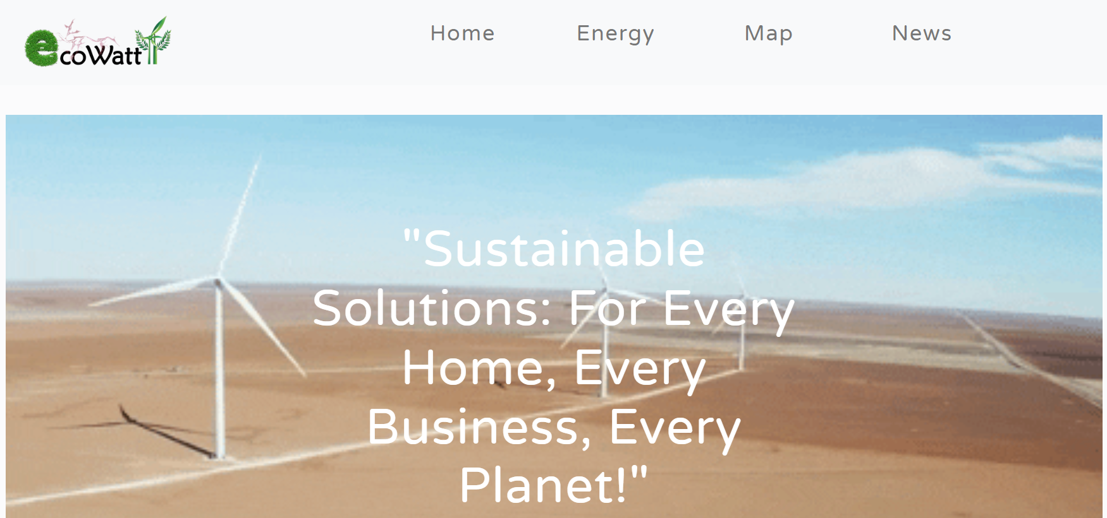
Ecowatt
Gagandeep Singh
12401857

Slide 2

Objective
Welcome to Ecowatt, a tool designed to help individuals and organizations transition to renewable energy and make a positive impact on our planet.
Key Points
Purpose: To provide tailored solutions for transitioning to renewable energy.
Target Audience: Homeowners, businesses, government agencies.
Importance: Addressing climate change and promoting sustainability

Slide 3

Feature Overview
Key Features:
Energy Calculator
Integrated Map
News Feed
Custom Chatbot
Educational Pages

Slide 4
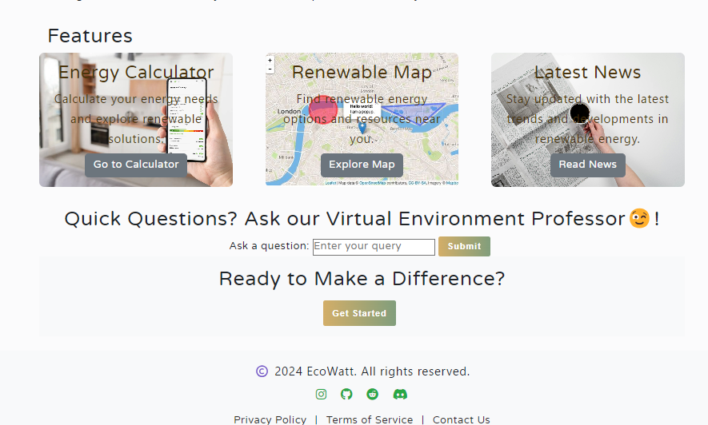

Slide 5
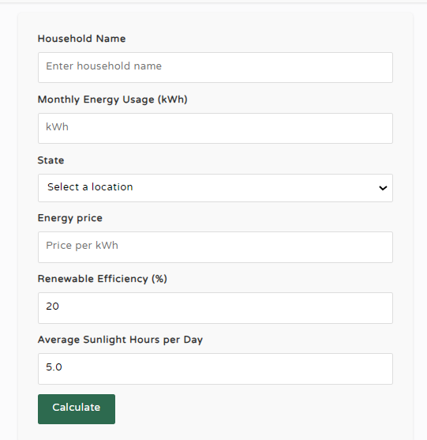
Energy Calculator
Our Energy Calculator helps users determine their solar energy needs based on their energy consumption and location.
How It Works:
Users input their monthly energy usage.
Select their state to get local energy prices.

Slide 6
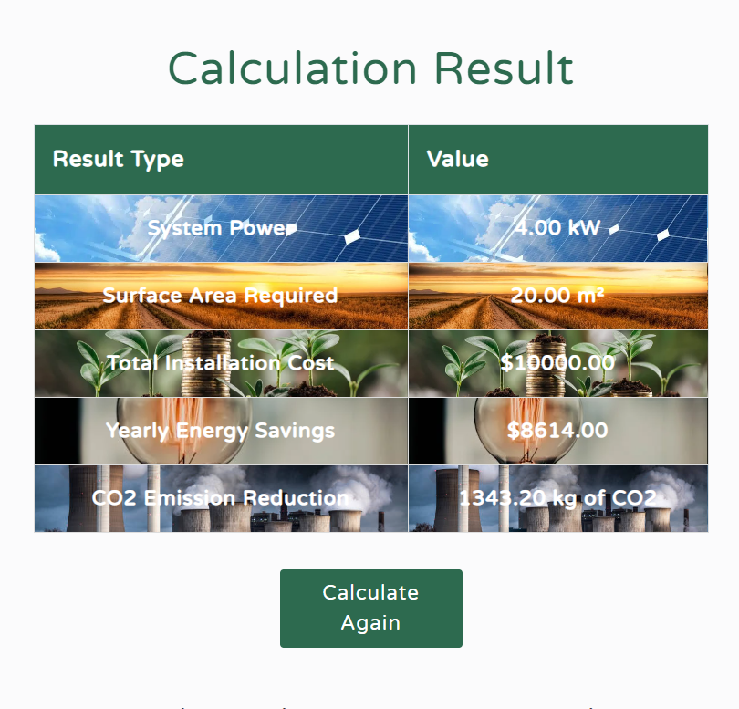
Result
The calculator provides:
Required solar system power
Roof area needed
Installation cost
CO2 emission reduction
Annual savings
List of local solar providers with details and links

Slide 7
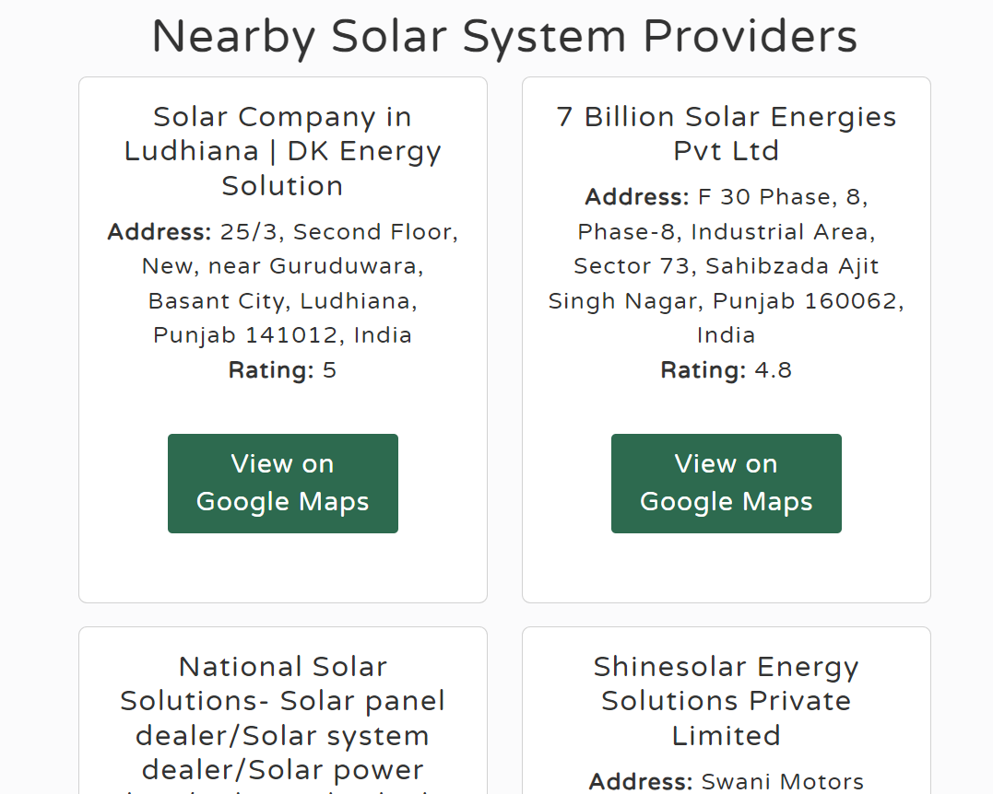
Detailed List of nearby Providers
As per user's state selection in previous page, my google places API fetches for all nearby solar system provider's details with their google links.

Slide 8
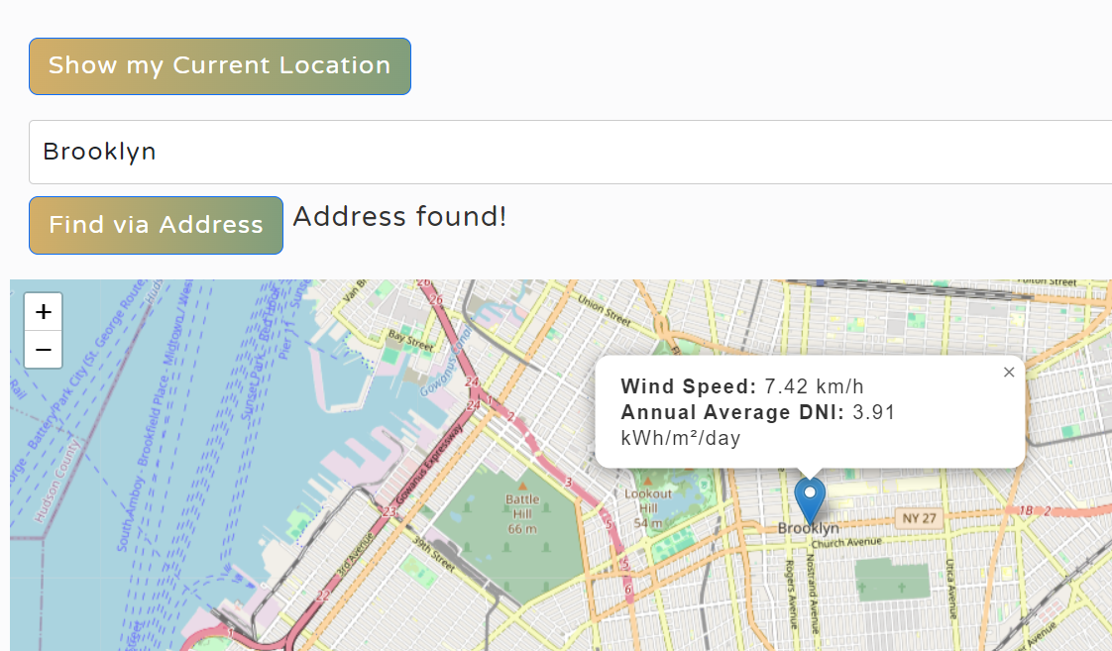
Integrated Map
Utilizes Leaflet API to provide real-time environmental data.
Features: Wind Speed and Solar Irradiation: Shows local wind speed and solar irradiation data, Solar Providers: Displays solar system providers on the map with details and contact information.
How It Helps:
Users can view and compare local environmental data.
Easy access to nearby solar providers.

Slide 9
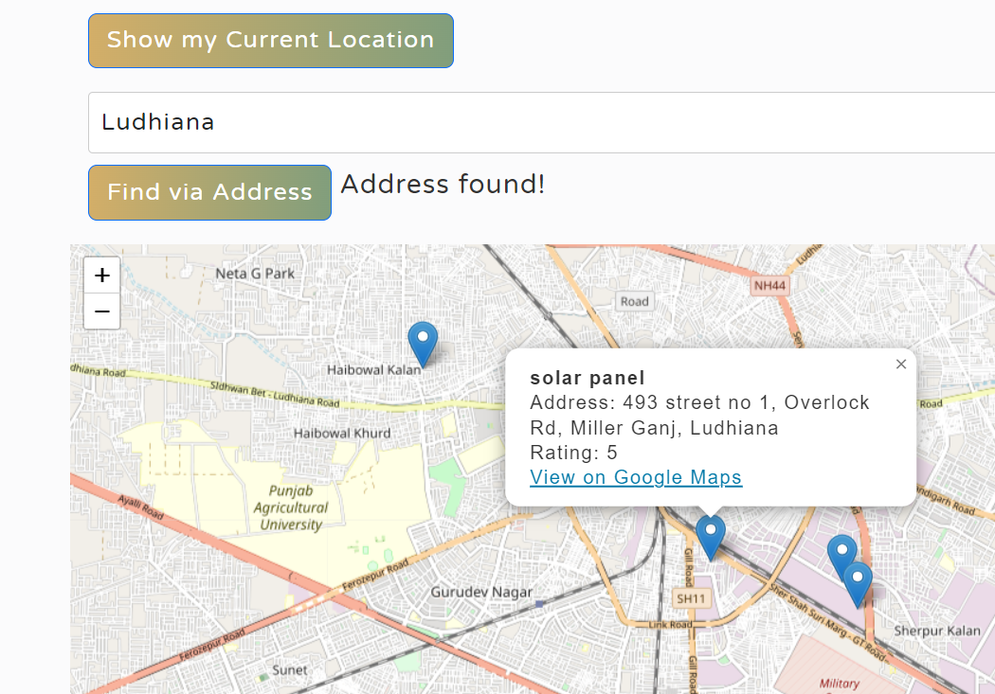

Slide 10
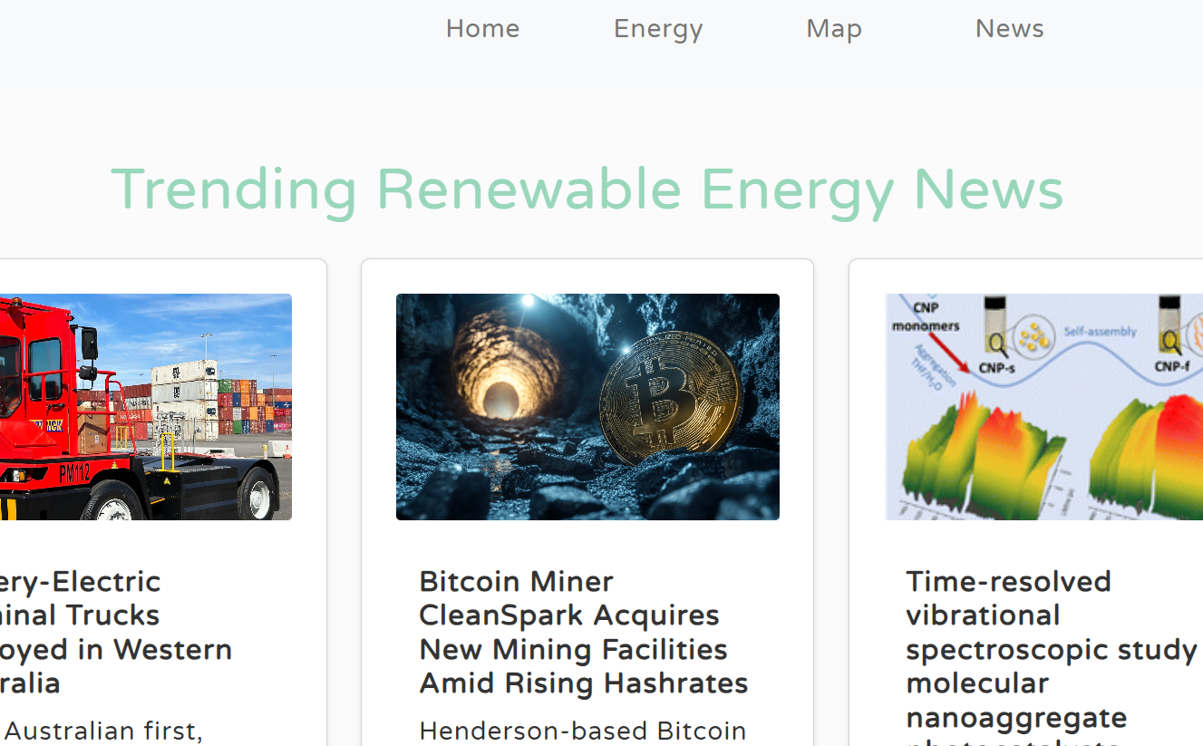
Auto-updating News Feed

Slide 11
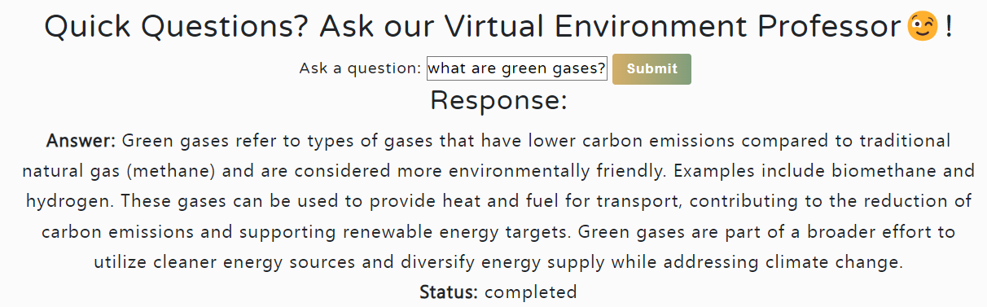
Custom Chatbot
Designed using OnDemand by feeding 5-6 book on renewable sources and solar energy.

Slide 12
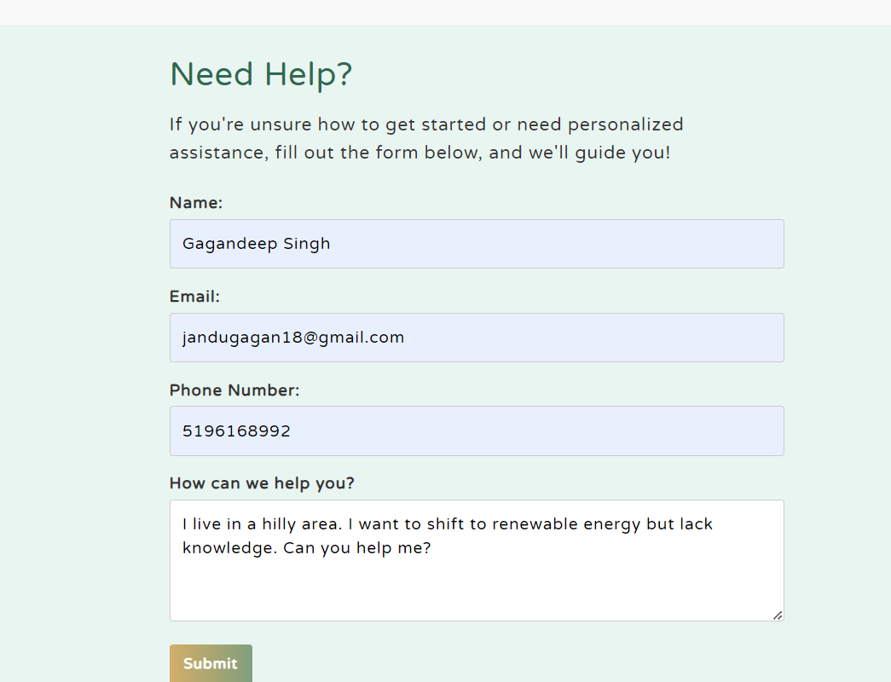
Still have second thoughts? Ask us for special treatment.

Slide 13
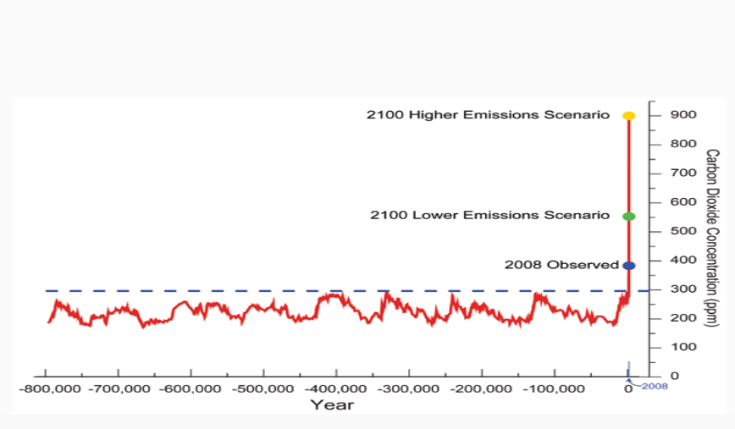
Educational Pages
Educational Pages:
In-depth information about renewable energy and its importance.
Content Includes:
Real Statistics: Data on the impact of renewable energy.
Importance: Why shifting to renewable energy is crucial for sustainability.

Slide 14

User Benefits
Benefits for Different Users:
Individuals: Learn how to reduce energy costs and environmental impact.
Businesses: Discover how to achieve sustainability goals and reduce operational costs.
Government Agencies: Access tools to support policy decisions and public awareness.
Key Takeaways:
Personalized recommendations and insights.
Access to relevant data and resources.

Slide 15

Contact and Support
Contact Information:
For support and inquiries, please reach out to me at:
Email: jandugagan18@gmail.com
Phone: +91 7696237189
Whatsapp: +1 5196168992

